Slide 1
Blazor: JavaScript? Where we’re going we don’t need JavaScript!!!
Robert taylor
Date: 2020-07-31

Slide 2


What is blazor?
Jacket?
Fancy Fireman Jacket?

Slide 3

What is blazor?
Anime character?
2019 Chevrolet?

Slide 4
What is blazor really?
Creates components that run server side AND client side with the same code! No more double logic!
Removes JavaScript as the primary language you must know for creating websites.
Allows .NET Core code to run on browsers that support WebAssembly (WASM)

Slide 5
What Is Webassembly (WASM)?
WebAssembly defines an Abstract Syntax Tree (AST) that gets stored in a binary format which allows us to create smaller app bundles but also allows for some “readability” for debugging.
It also runs side by side with JavaScript.

Slide 6

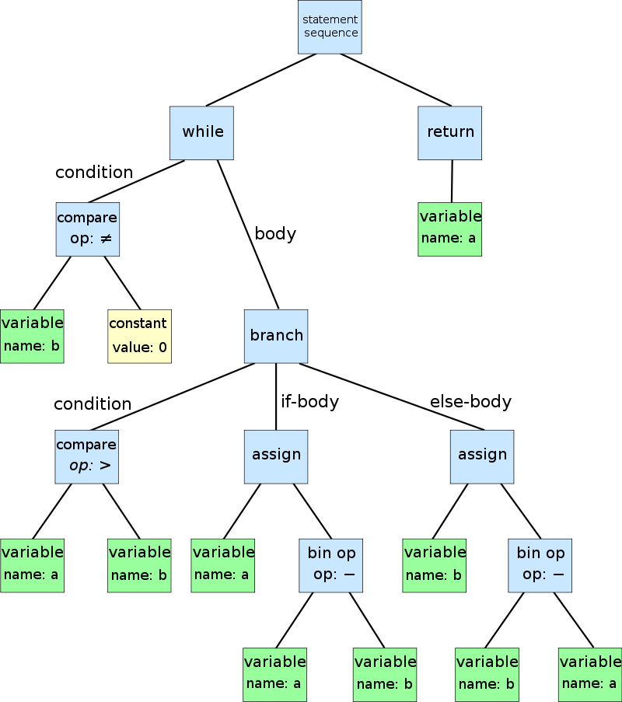
while b ≠ 0 if a > b a := a − b else b := b − a return a

Slide 7
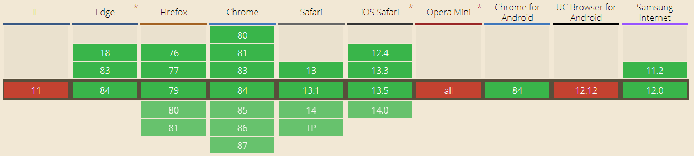
Who supports wasm?
https://caniuse.com/#feat=wasm
This represents 92% of the market and shows the top 10 browsers and their active versions
7% of global use in this group does not support WASM

Slide 8



What do you get with BLAZOR SERVER
Server-side
https...
ASP.NET Core
SignalR
DOM
Razor Components
.NET

Slide 9
What do you get with BLAZOR clientside
Client-side
https://...
Razor Components
DOM
.NET
WebAssembly

Slide 10
BlazOr options?
Server Side
Faster browser load times
More .NET libraries and features available
Protect your intellectual property
Client Side
Be able to run disconnected
Offloads work to browsers instead of server
If no data is needed from server, app will run faster

Slide 11
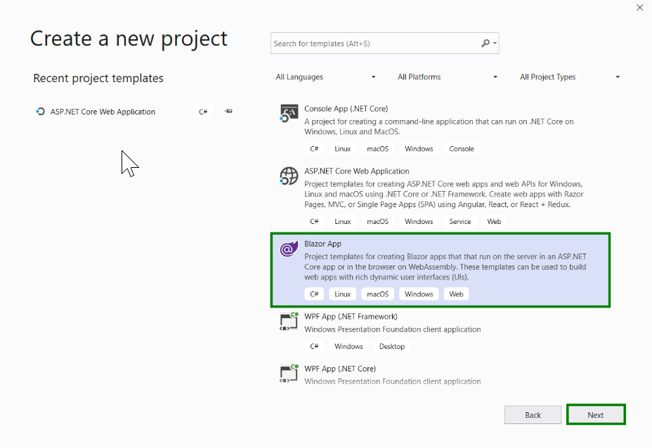
Creating a new blazor app

Slide 12
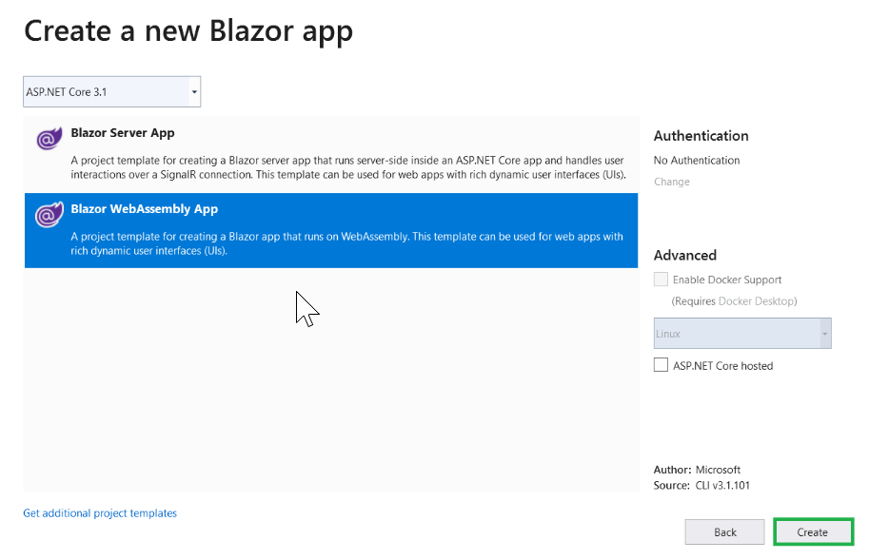
Creating a new blazor app

Slide 13
Later improvements
Precompile .NET Core libraries into WASM

Slide 14
Show me some code!!!!!!
Approaching 88MPH!!!

Slide 15
Points
Show creating a new Project
Show files
Show binding (Counter) and OnOnit() (FetchData)
Rename issue… restart VS
Show exception in app
Show debug via Console.WriteLine
Mono.js – API
blazor.webassembly.js – JSRuntime (JS Interop) - You can still leverage existing JS libraries
Show WASM debugger.
Show Sudoku app.
Speed.
NuGet controls

Slide 16
Developer points
Setup Unit Tests because much easier than WriteLine debugging!
If something is misbehaving, just restart VS and see if that fixes it.
Read: https://docs.microsoft.com/en-us/aspnet/core/blazor/?view=aspnetcore-3.1

Slide 17
Questions?

Slide 18
Blazor: JavaScript? Where we’re going we don’t need JavaScript!!!
Robert taylor

